Slide 1



economic ANALYSIS and forecasting macroeconomic aggregates
Jasvinder Singh

Slide 2
INTRODUCTION
The world is navigating through turbulent economic times, marked by uncertainties and challenges. In response to this global upheaval, our project aims to provide a comprehensive assessment of the world economy, with a particular focus on forecasting the macroeconomic aggregate of unemployment. Our objective is to unearth crucial insights that will serve as the key to unlocking the economic potential of regions that have, until now, faced economic constraints.

Slide 3





agenda
Global Overview
G20 , G7 and BRICS
BRICS Economic Projections
Comparative analysis
Forecasting unemployment

Slide 4
g20 focused strategic approach
Global Overview:
Comprehensive examination of the global landscape.
Focus on G20, representing 19 sovereign nations, the EU, and the African Union.
G20 contributes around 80% to the Gross World Product (GWP) and 75% to international trade.
G20 Scope - G7 and BRICS:
Zooming in on G7 and BRICS within the G20.
Positive correlation observed between unemployment rates and GDP growth in BRICS.
Despite economic growth, employment creation in BRICS lags.
BRICS Economic Projections:
BRICS economies, especially China and India, poised as major global contributors.
China's GDP represents 18% of the world, while India's is 3%.
India's demographic dividend projected until 2055–56, necessitating strategic government investments for concurrent employment and economic growth.
Comparative Analysis:
Benchmarking India against other global economies.
Distilling insights for informed policy interventions and strategic initiatives.
Forecasting Unemployment:
Concluding with a forecast of the Unemployment Rate (UR) in India.
Commentary on recommended measures to address unemployment, emphasizing multifaceted approaches aligned with India's demographic dynamics and economic aspirations.

Slide 5
METHODOLOGY
STEP 01
STEP 02
Data Sourcing and Data Preprocessing
Data Analysis
STEP 04
STEP 03
Conclusion
Forecasting

Slide 6
01. SECTION
World and Bloc Analysis

Slide 7

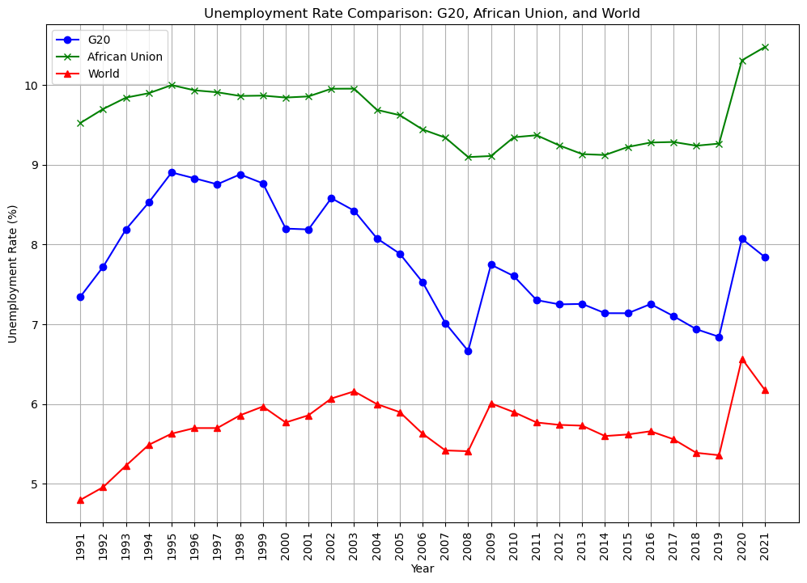
Unemployment Rate Comparison: G20, African Union, and World
The unemployment rates reveal a notable trend, with the African Union consistently higher than the G20, which in turn is higher than the global average.
This suggests untapped economic potential in the AU. However, our analysis will focus on the G20, a major driver of the world economy, to uncover insights and potential implications.

Slide 8
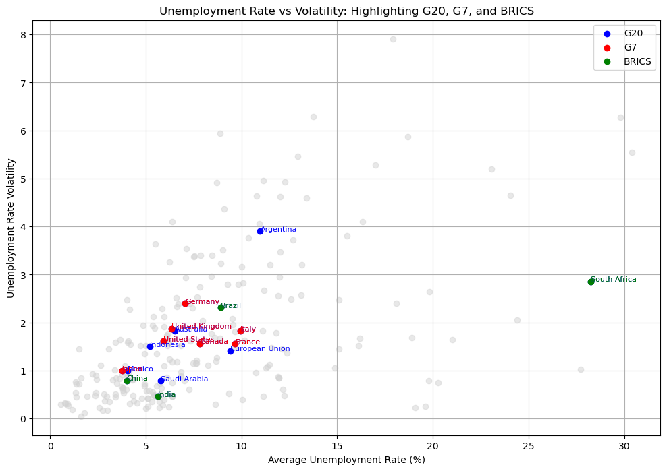
Unemployment Rate vs Volatility: Highlighting G20, G7, and BRICS
This visualisation shows that G20 countries are a good representation of all countries in the world. Any insights on them will be applicable to majority of the world.

Slide 9
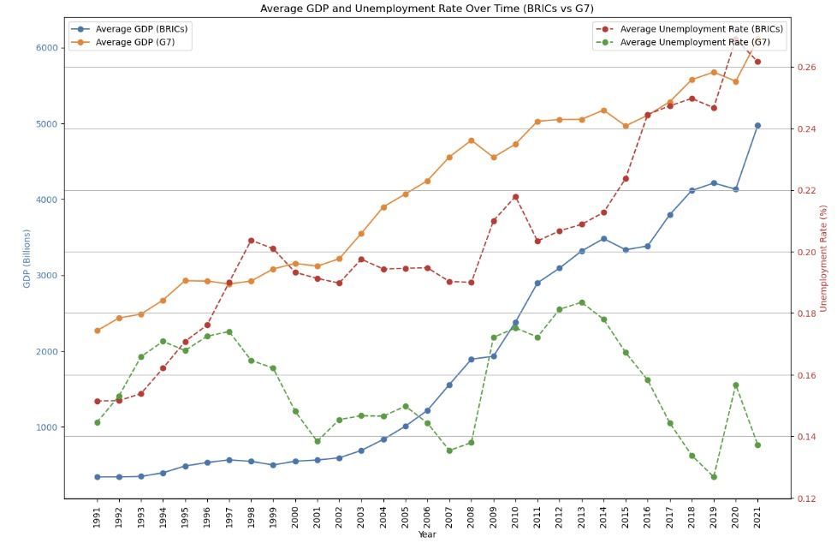
Average GDP and Unemployment rate over time (brics vs g7)
In the G7 countries, a discernible negative correlation between GDP and unemployment rates signals simultaneous economic growth and job creation. However, in BRICS nations, a positive correlation indicates that despite robust economic expansion, job growth has not kept pace. This nuance emphasizes the need for targeted employment strategies amid rapid economic development.

Slide 10
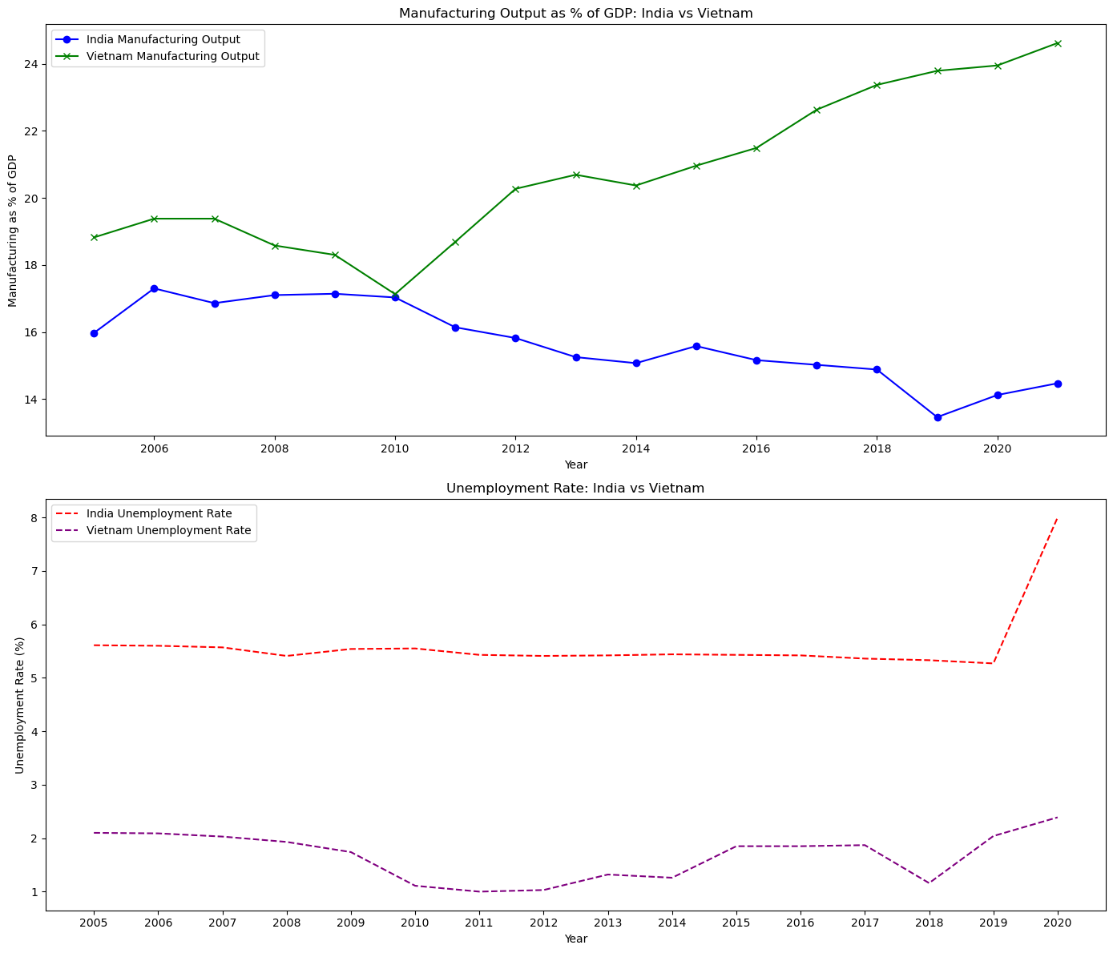
Comparative Analysis
Vietnam's manufacturing output is driven by low cost of labor, and its strategic location next to major trade routes in south asia.
As a result, Vietnam’s manufacturing sector is a significant growth driver, and it positively correlates with employment stability.

Slide 11
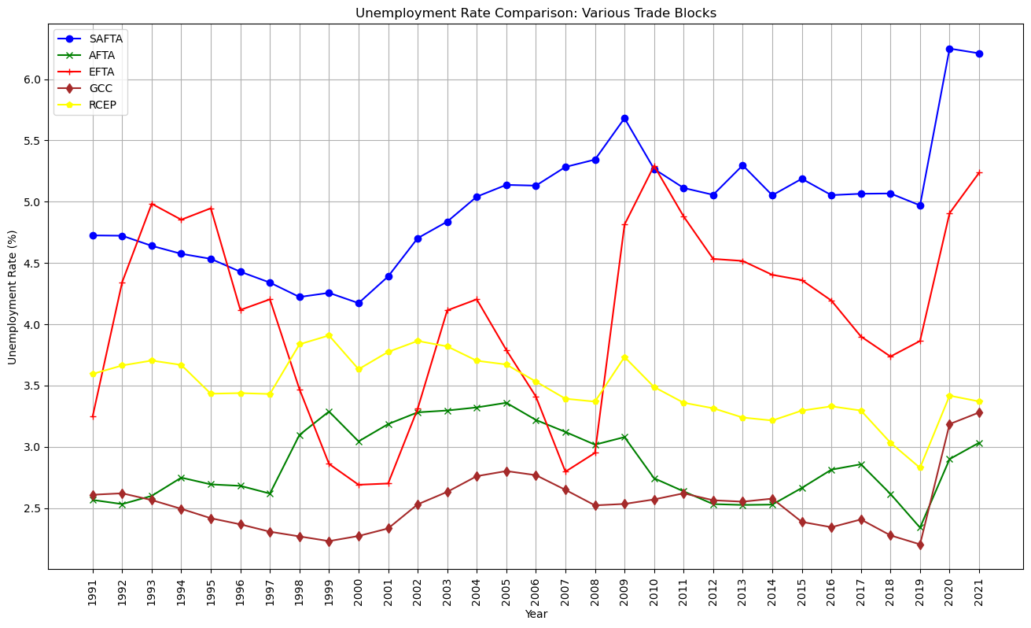
Unemployment rate comparison of various trade blocs
Regional trade serves as a catalyst for economic growth, fostering an environment where businesses can seize new market opportunities. This heightened trade activity not only spurs increased production but also generates more employment, contributing to comprehensive economic development within the region.

Slide 12
02. SECTION
Forecasting

Slide 13
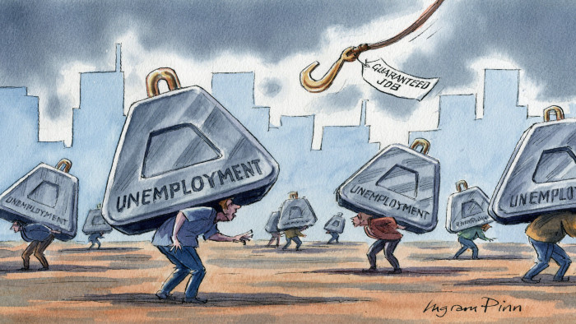
Why forecast unemployment
Our world is ruled by uncertainty. The ability to forecast macroeconomic aggregates such as unemployment, is an important Ingredient in the design of macroeconomic policies.

Slide 14
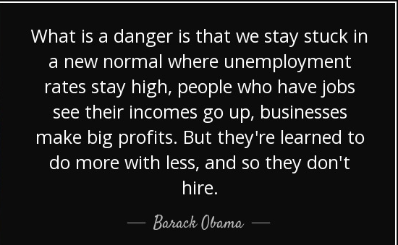

Slide 15
Data Overview
Obtained data from U.S. Bureau of Labor Statistics, Unemployment Rate [UNRATE], retrieved from FRED, Federal Reserve Bank of St. Louis; https://fred.stlouisfed.org/series/UNRATE, December 6, 2023.
Data set contains monthly data of unemployment rate of US from "January 1 2010" to "December 31 2019".
ARIMA forecasting models can be used to predict future values of a time series based on historical data. However, predicting the specific occurrence and impact of a recession is challenging for several reasons.

Slide 16
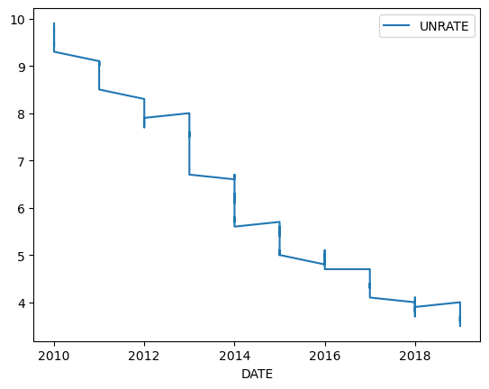
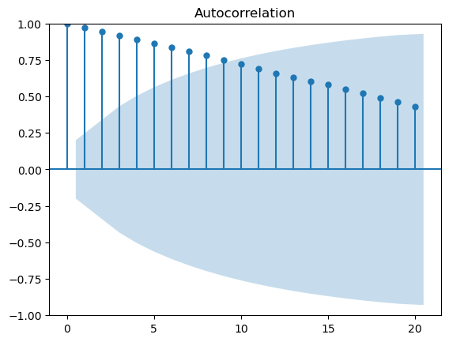
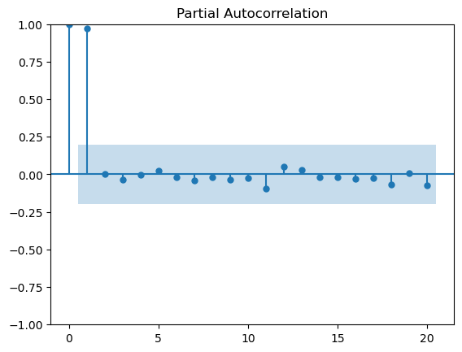
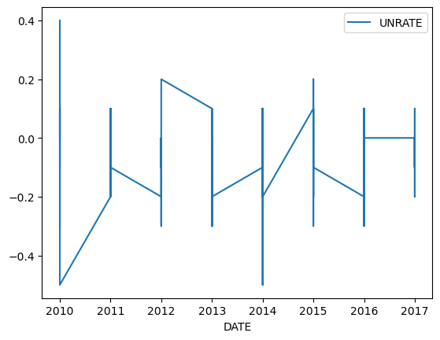
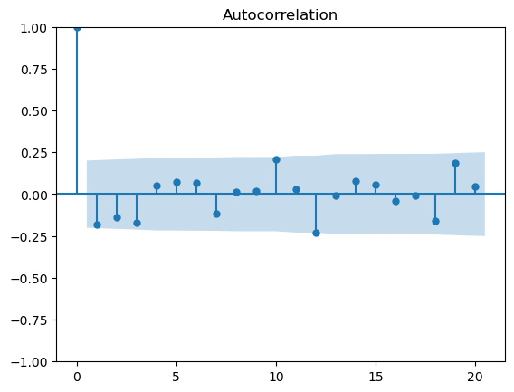
Forecast
Test for stationarity and Identification
ADF test - p-value: 0.676812124847063
Differencing
ADF test - p-value: 1.9204588733955935e-13

Slide 17
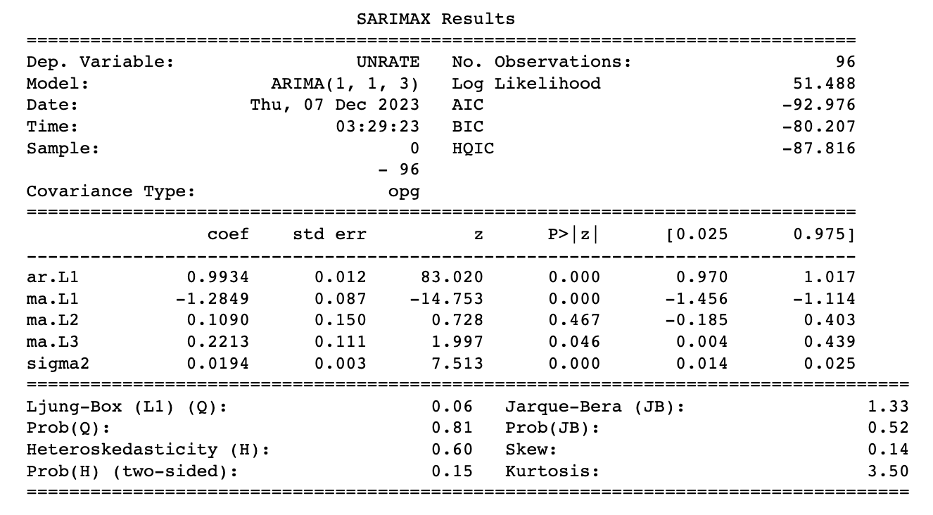
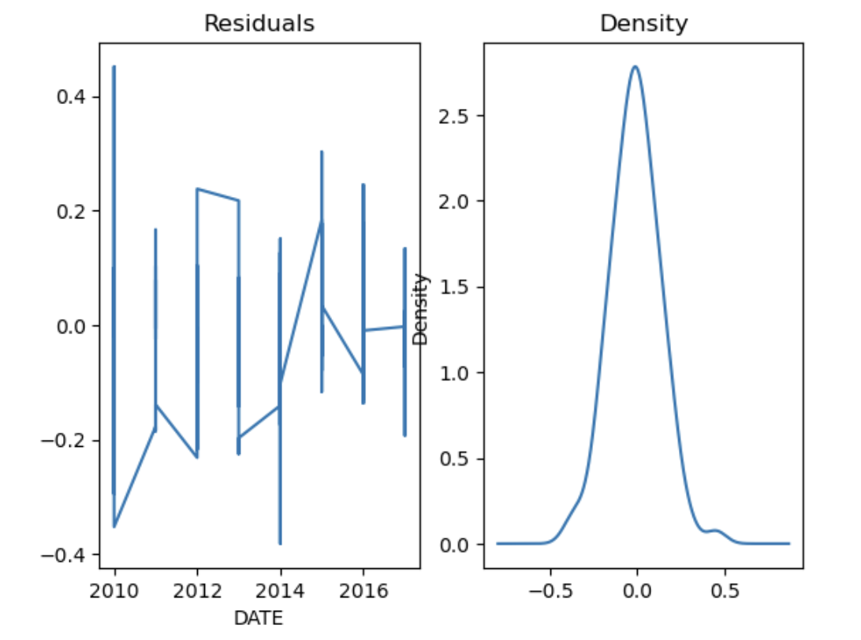
Forecast
Estimation and Diagnostics
We determine p, q using goodness of fit measure AIC. Lower AIC values indicate a better trade-off between model fit and complexity. Therefore, we choose the combination of p, q that minimizes the AIC.
We fit the model.
Check for randomness and normality of residuals: important for ensuring that the model captures the underlying patterns in the data.

Slide 18
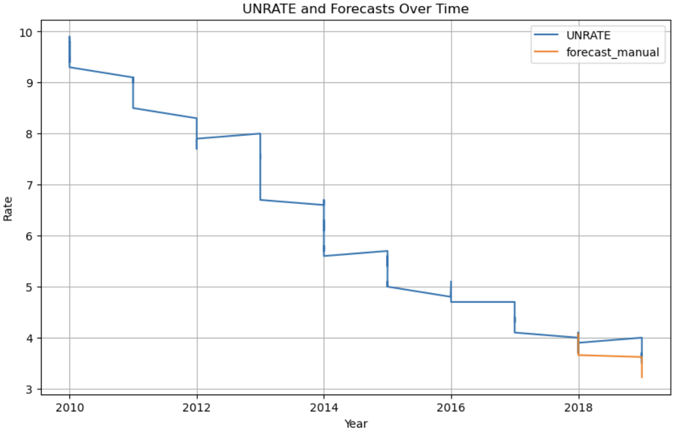
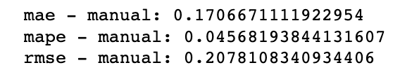
Forecast
Forecasting

Slide 19
Going ForWARD
a
b
Sectoral Analysis: Different sectors of the economy may experience varying levels of unemployment. Forecasting unemployment allows for a more granular analysis of the impact on specific industries and occupations.
While ARIMA models may not directly predict the occurrence of a recession, they can be valuable in forecasting economic indicators (such as GDP, unemployment rates) and understanding trends in the data.

